Slide 1
TABU SEARCH METHOD

Slide 2
1. How the program works
-Initialization
-Structure of the algorithm
-Evaluation Function
-Successor Function

Slide 3
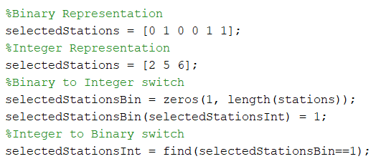
1.1- Initialization
Mostly the usual: satellite data + Taboo Search data
TabuList holds a cell per every station
Integer representation of representative stations.
Not much difference between binary or integer.

Slide 4
1.2- Structure of the algorithm
Very similar to the generic Taboo Search structure.
Matrix of successors has two extra columns: the value of the successor, the change from the parent.
Stopping conditions are a total maximum and a maximum without improvement: 500, 20.
Parent 1 | 2 | 5 | Value 138.42 | Change -
3 | 2 | 5 | 141.23 | 3
1 | 7 | 5 | 156.75 | 7
1 | 2 | 6 | 137.89 | 6

Slide 5
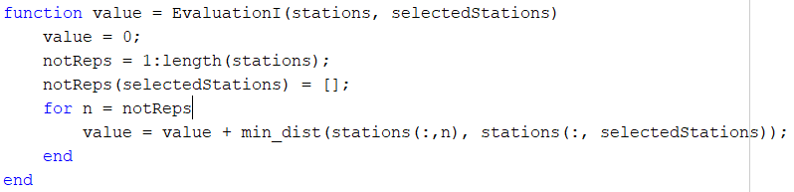
1.3- Evaluation Function
Standard method: get all the not-representative stations, then add the distances of each to its closest representative.

Slide 6
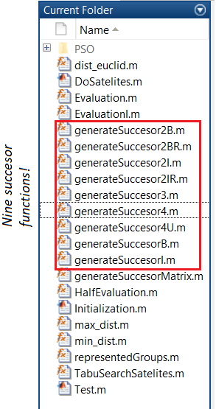
1.4- Successor function
* Requires a varLevel parameter, determines the n-th selected station to be altered.
We tried different methods to replace the n-th selected:
By the next one in the array
By its closest station
By the furthest station represented by it.
By the station closest to the mean point of all of its group of represented stations.

Slide 7
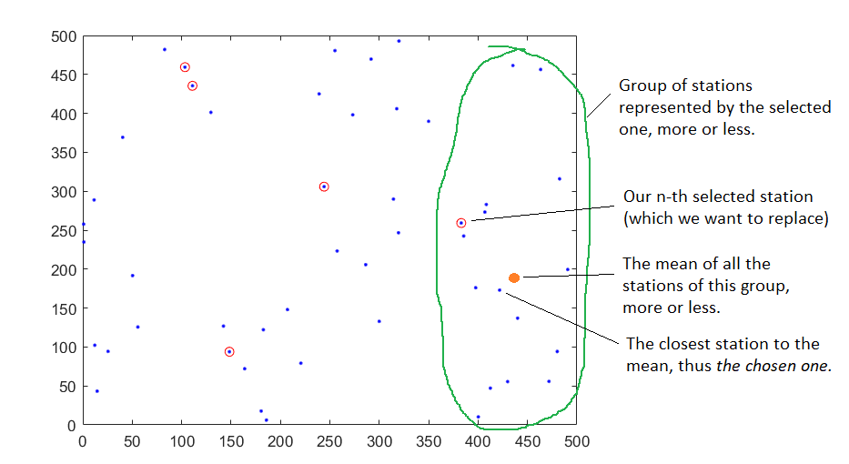
In the end, the 4th method proved best, by a decent margin.

Slide 8
2. Choices of implementation

Slide 9
2.1- Why integer, not binary representation?
In the end, both had extremely similar efficiencies when tested.
(Plus we can switch between them with ease)
So, this didn’t have a big impact on the overall efficiency.
Integer used less memory, and it was easier to use with the following…

Slide 10
2.2- Auxiliar array: “represented”
Length: N (500).
In position n, stores the station that represents n.
If n is a representative, stores a 0.
Representatives | 3 | 6 | 8
Represented | 3 | 8 | 0 | 6 | 6 | …

Slide 11
2.2.1- why is this array useful?
Both the evaluation and the successor function use these “groups of represented”.
Tests lead to the evaluation function being ~20 times faster with this array.
Successor function went from 2*10e-3 to 4*10e-6.
500 times faster!!

Slide 12
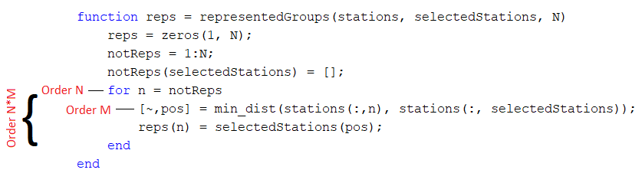
2.2.2- There are drawbacks…
To create this auxiliar array we call the function: “representedGroups”.
This function is very costly, order of N*M.
A call to this function plus either evaluation or successor completely negates all improvement…

Slide 13
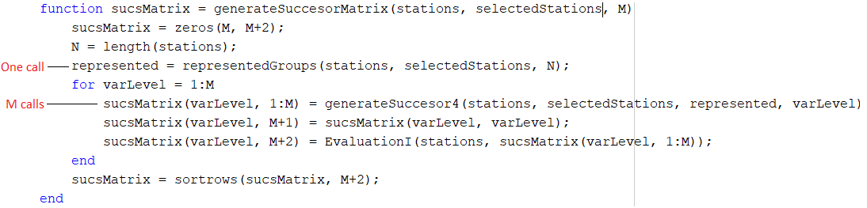
Solution: minimize the calls to the function
The successor function needs the represented array of the father.
1 father -> M successors.
We can’t save the evaluation function, it stays inefficient :(

Slide 14
3.- conclusions of taboo Search
It’s relatively quick! We optimized every operation as much as possible.
Total of iterations remain low. For 500 stations it finishes in under 100!
Often gets good results: ~1.35 e4
*Possible drawback? Results might become worse with low number of stations, due to the successor method.
But we couldn’t really confirm it.

Slide 15
Satellites problem solution
Solved with Particle swarm optimization algorithm

Slide 16
Pso - motivations
Standard implementation
Acceptable solutions
Different approaches
Convenient convergence

Slide 17

PSO – NOT ALL is GOLD
Local optimum not guaranteed
Performance
Best solution
Tweaks needed

Slide 18
PSO – NOT ALL is GOLD
Local optimum not guaranteed
Performance
Best solution
Tweaks needed

Slide 19

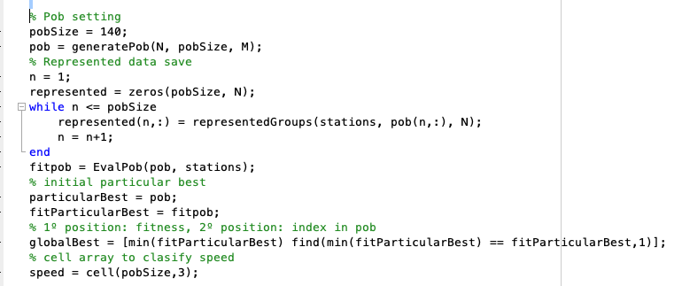
PSO - Basic Scheme - Initialization
Similar to Taboo.
Population settings provided
“The keys”:
Speed
Position

Slide 20
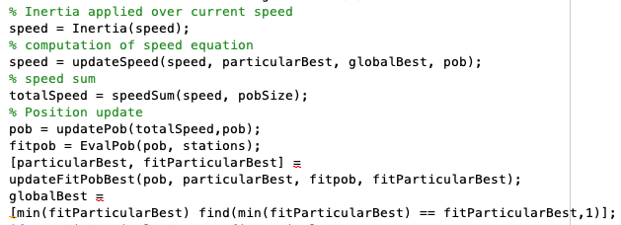
Pso – basic scheme – body algorithm
The same for any problem
Deeper slight differences
18 functions in total

Slide 21

Pso – basic scheme - Stopping criteria
Time
Iterations
Stallation
Acceptable solution

Slide 22
Satellites - Representation
Floating satellites
Random population
Initial speed = 0

Slide 23
Satellites - Representation
Floating satellites
Random population
Initial speed = 0
Inertia, particular and global coefficients previously decided

Slide 24
Satellites - Representation
Floating satellites
Random population
Initial speed = 0
Inertia, particular and global coefficients previously decided
Population size → “Big problems requires bigger populations”

Slide 25
Satellites - possibilities
Two of them:
Converge to the best computing differences

Slide 26
Satellites - possibilities
Two of them:
Converge to the best computing differences
Converge to the best through exchanges

Slide 27
PSO – obtaining results
BALANCE

Slide 28
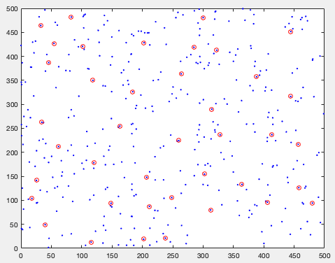

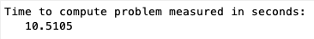
PSO – obtaining results
BALANCE
Testing

Slide 29
Thank you all!
ANY Questions?

